Slide 1
Lakehouse Monitoring
Data Quality with Intelligence

Slide 2
Why do I need to monitor data quality?
Notes:
Without a data quality solution, we often common problems among data engineering and ML teams. Do any of these situations sound familiar to you?

Slide 3



Challenges in adopting Data Quality tools
Hard to scale
Noisy alerts
High friction
Notes:
High friction – It’s high effort to integrate separate tools across data engineers, analysts, and ML, especially when tools live apart from the data platform
Hard to scale – It’s hard to scale a variety of frameworks and have teams learn multiple solutions
Noisy alerts – It’s challenging to write rules with complex patterns like seasonality or changing ranges. This often leads to disruptive alerts that are hard to filter.
These are all challenges that we’ve thought a lot about and we believe that Lakehouse Monitoring is the solution by allowing you to address any data quality concern directly in Databricks, directly with your data platform. Let’s explore how:

Slide 4
What is Lakehouse Monitoring?

Slide 5
Teams want to monitor many assets.
Bronze, Silver, Gold
Time Series
MVs, STs
Features
Model
Model
Inference Table

Slide 6
Data and AI assets come from many frameworks
dbt
DLT
Workflows
DB Serving
3rd-party Serving
Bronze, Silver, Gold
Time Series
MVs, STs
Features
Model
Model
Model
Inference Table

Slide 7

Lakehouse Monitoring
Profile, Diagnose, and Enforce Quality for any table in the UC.
dbt
DLT
Workflows
DB Serving
3rd-party Serving
Dashboard
Bronze, Silver, Gold
Time series
MVs, STs
Features
Model
monitor
monitor
monitor
monitor
Inference Table
Profiling Data
Table
Expectations and Alerts
monitor
Data Drift
Table

Slide 8


What is Lakehouse Monitoring
Data
Automated profiling of any Delta table
Lakehouse Monitoring
Quality across your entire data + AI estate
AI
Model drift and performance
Unity Catalog
Metadata
Governance
Serverless
Notes:
Unified approach to monitoring data and AI: Profile, Diagnose, and Enforce quality across any table
Built into Unity Catalog: Get data quality alongside governance
Fully Serverless: Never worry about infrastructure or tuning compute configuration

Slide 9
Announcing
Lakehouse Monitoring is Generally Available
Author Name Date

Slide 10

Deep dive demo
DAIS Lakehouse Monitoring Talk with the Product team
Notes:
Detect common issues like duplicates, incompleteness, or drift before they trickle downstream
Enforce data quality checks directly in workflows
Get alerted, Fail a job or Drop a record upon violation

Slide 11
Why Lakehouse Monitoring?
=
High friction
Notes:
From Friction → Simplicity

Slide 12

Why Lakehouse Monitoring?
=
Simple
High friction
Notes:
Simple – Automated profiling out of the box

Slide 13
Why Lakehouse Monitoring?
=
=
Simple
High friction
Hard to scale
Notes:
Instead of being hard to scale, LHM is scalable

Slide 14

Why Lakehouse Monitoring?
=
=
Simple
Scalable
High friction
Hard to scale
Notes:
Scalable – Unified solution for data and AI, works on any table in Unity Catalog

Slide 15
Why Lakehouse Monitoring?
=
=
=
Simple
Scalable
High friction
Hard to scale
Noisy alerts
Notes:
Instead of getting bombarded with noisy alerts, LHM is intelligent

Slide 16

Why Lakehouse Monitoring?
=
=
=
Simple
Scalable
Intelligent
High friction
Hard to scale
Noisy alerts
Notes:
Intelligent – Forecasts quality thresholds and automates expectations, reducing noise.

Slide 17

“Lakehouse Monitoring has been a game changer. It helps us solve the issue of data quality directly in the platform... it's like the heartbeat of the system. Our data scientists are excited they can finally understand data quality without having to jump through hoops.”
– Yannis Katsanos, Director of Data Science, Operations and Innovation
Notes:
Ecolab is a global leader in sustainability and relies on data-driven insights to optimize water and energy use. Here’s a quote from their Director of Data Science on how they found success with Lakehouse Monitoring to maintain quality for all their operations in data science:

Slide 18
Roadmap

Slide 19
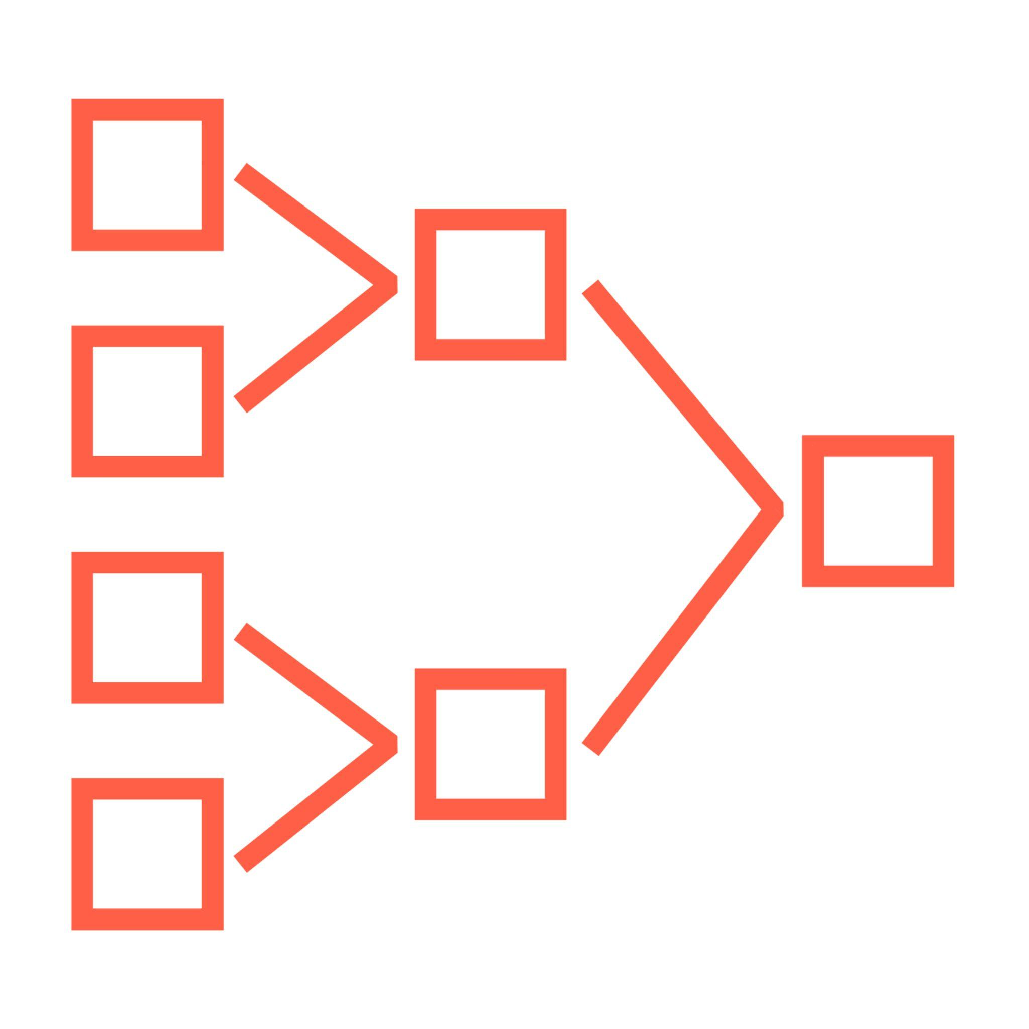


Expectations
DLT
Enforce quality on MVs and STs
Unified
Enforce quality for any UC table
+ unify syntax for:
DLT Expectations
PK/ FK constraints
Lakehouse Monitoring metrics (e.g. count, percent_null)
Notes:
You may be wondering how this differs from DLT Expectations. DLT has always allowed you to use expectations for data quality on MVs and STs, now we’re bringing this capability to any table in Unity Catalog and aligning the syntax so that it’s one streamlined experience to enforce quality. In addition to row-level constraints, you can use LHM to enforce aggregate constraints on data at rest (e.g. count or percent_null which require the whole table to be written.)

Slide 20
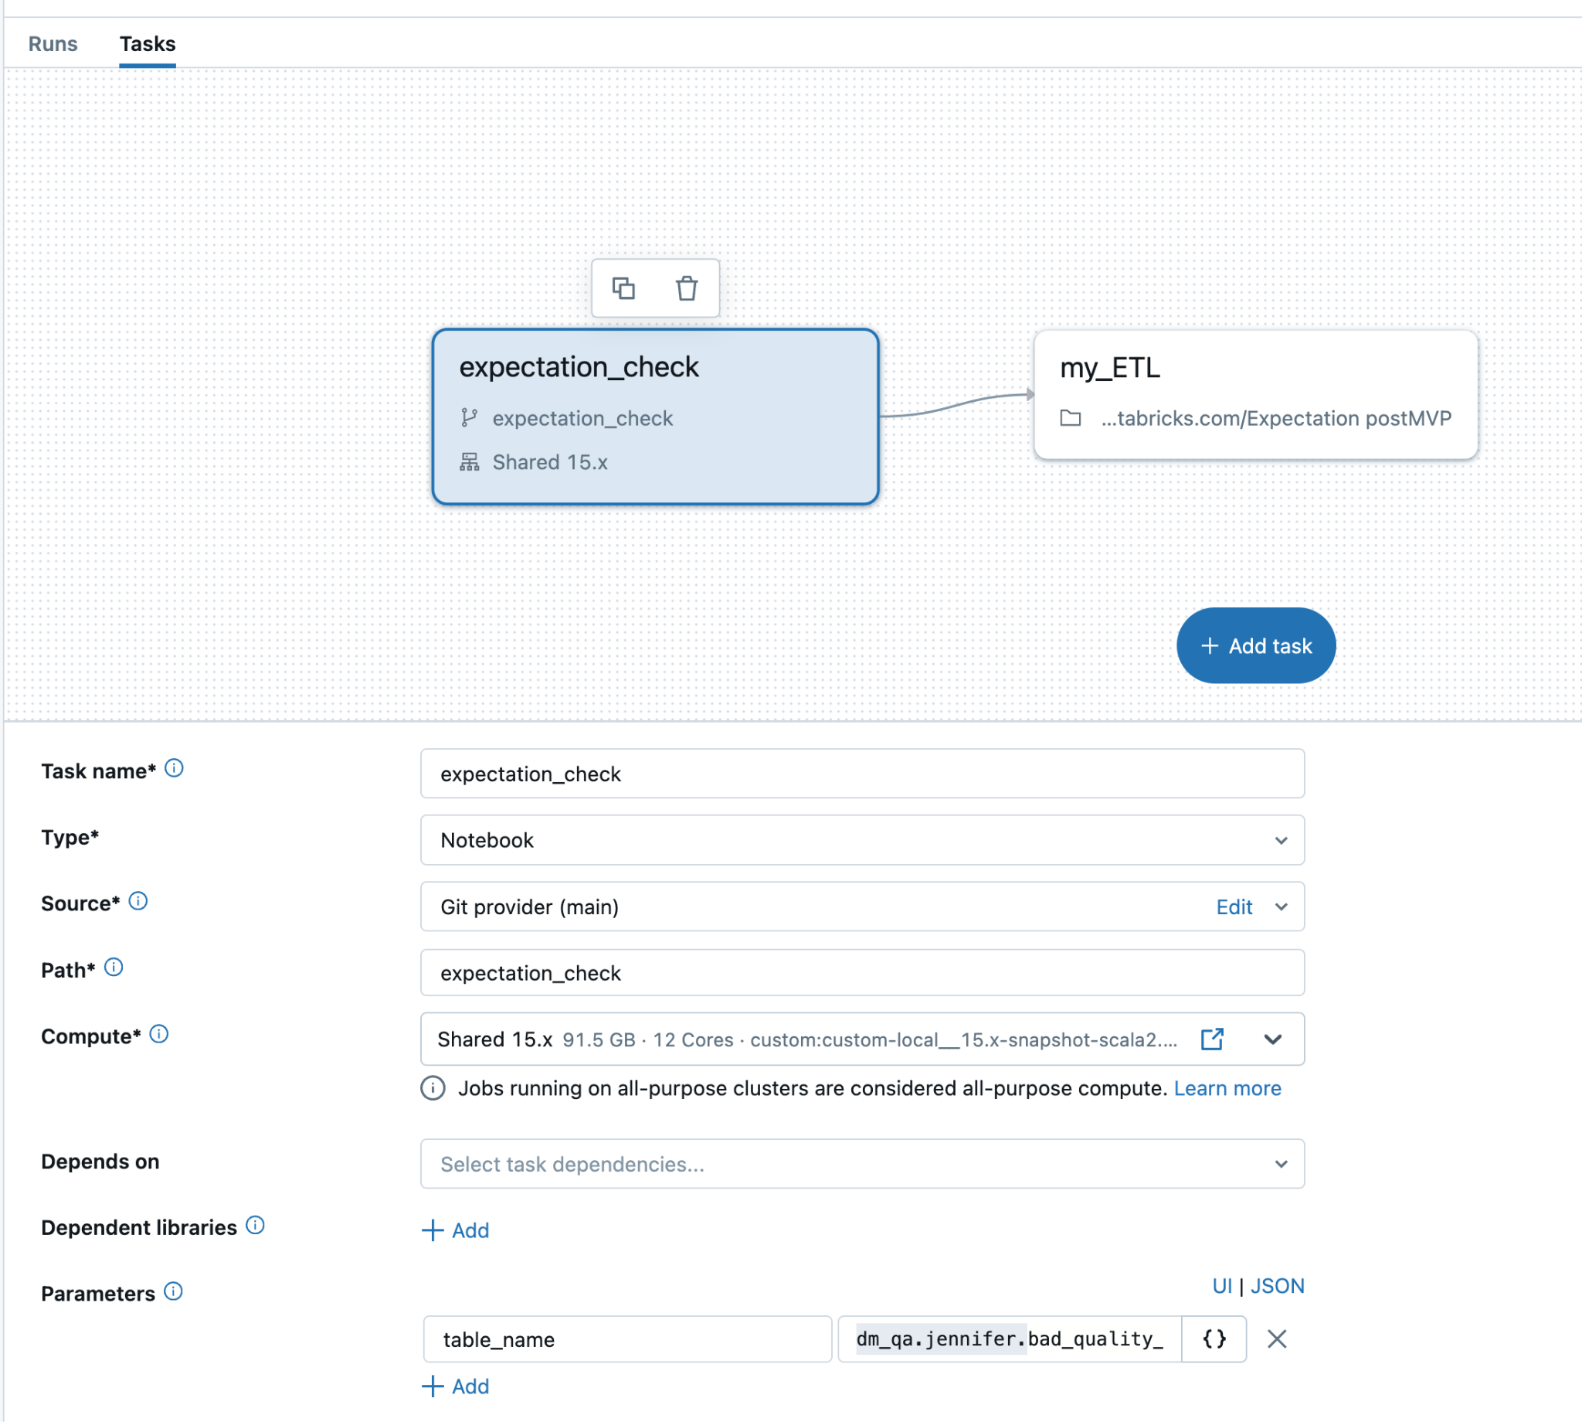
Expectations
In Private Preview
Prevent data quality issues from trickling downstream
ALTER TABLE main.schema.user
ADD CONSTRAINT PRIMARY KEY (user_id)
ADD CONSTRAINT METRICS percent_null(col=>”product_name”) < 0.05
Enforce data quality checks directly in workflows
🔔 Get alerted
⛔ Fail a job
❌ Drop a record
Notes:
Detect common issues like duplicates, incompleteness, or drift before they trickle downstream
Enforce data quality checks directly in workflows
Get alerted, Fail a job or Drop a record upon violation

Slide 21
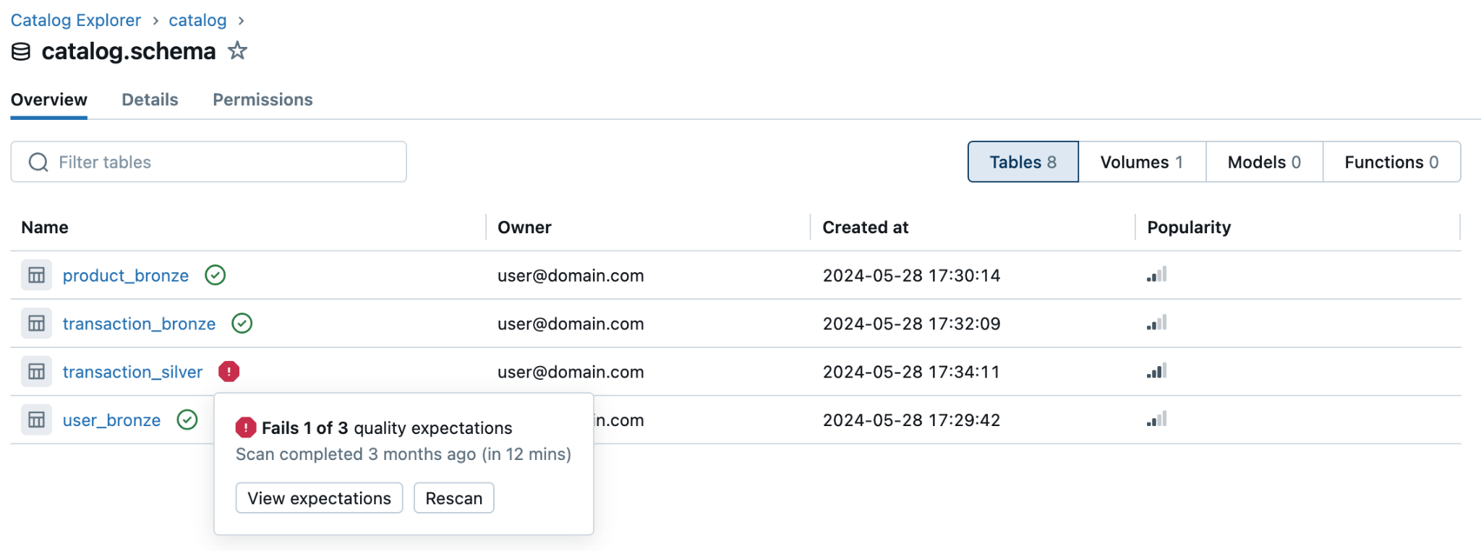
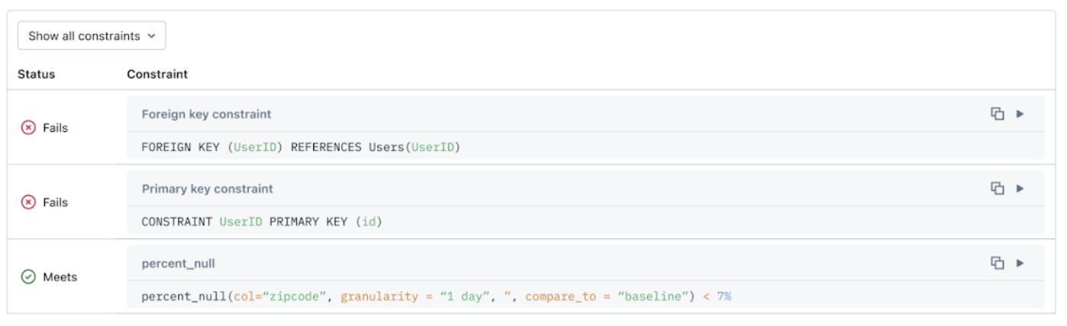
Health Indicator
Coming soon
Understand the health of your tables at a glance
One-click query to debug violating records
Health indicator for every table
Notes:
Lakehouse Monitoring allows you to tie expectations directly in your pipelines to prevent the silent decay of quality. By integrating quality checks directly into your workflows, you can get alerted or fail a job if any table violates your quality rules. Detect common problems like duplicates, incompleteness, and distributional change in your data before they trickle downstream. In the future, Lakehouse Monitoring plans to intelligently set quality thresholds based on data profiling and forecasting. We are excited for what’s to come and encourage you to join our Public Preview for the feature here.

Slide 22
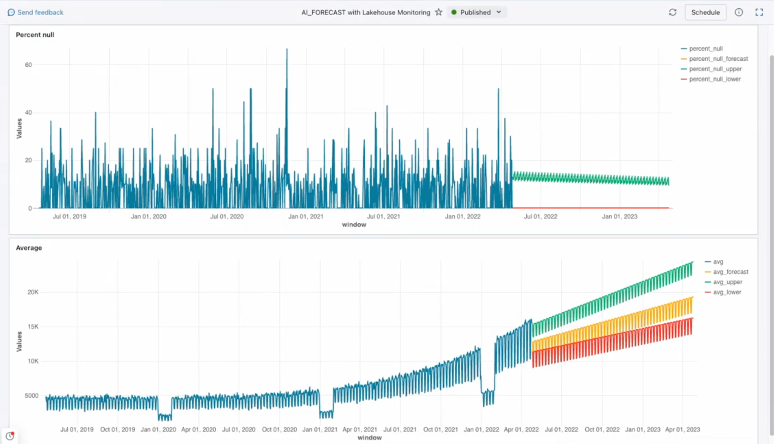
Intelligent Forecasting
Coming soon
Write Expectations with AI suggested thresholds
Set thresholds with confidence and reduce noisy alerts

Slide 23
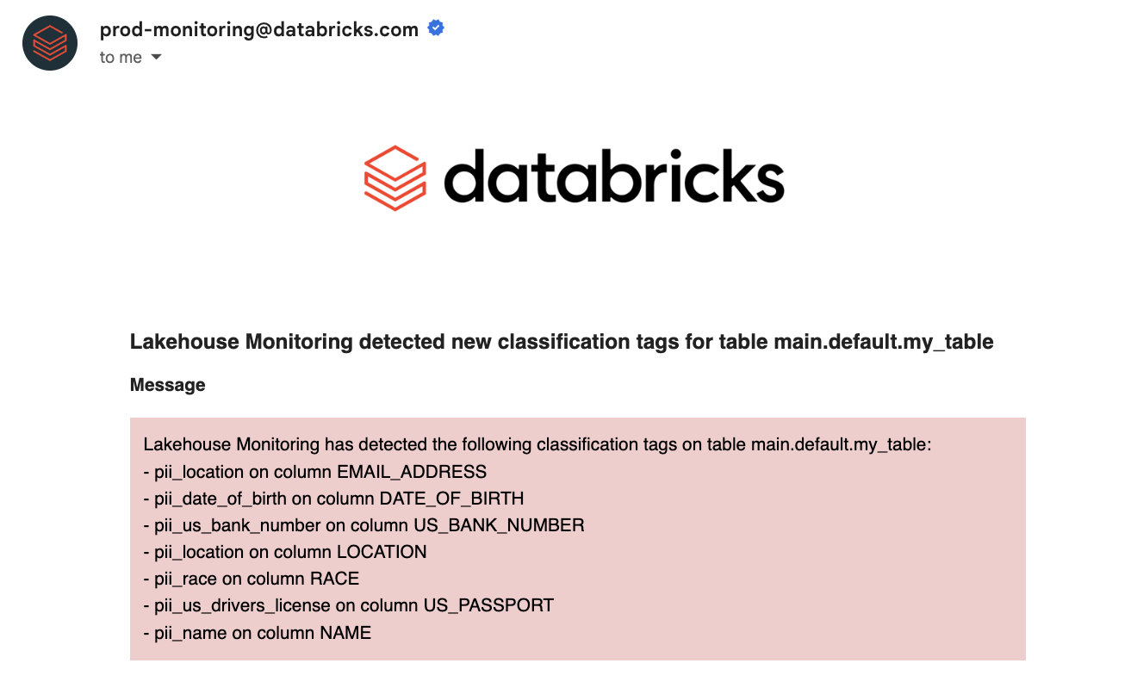
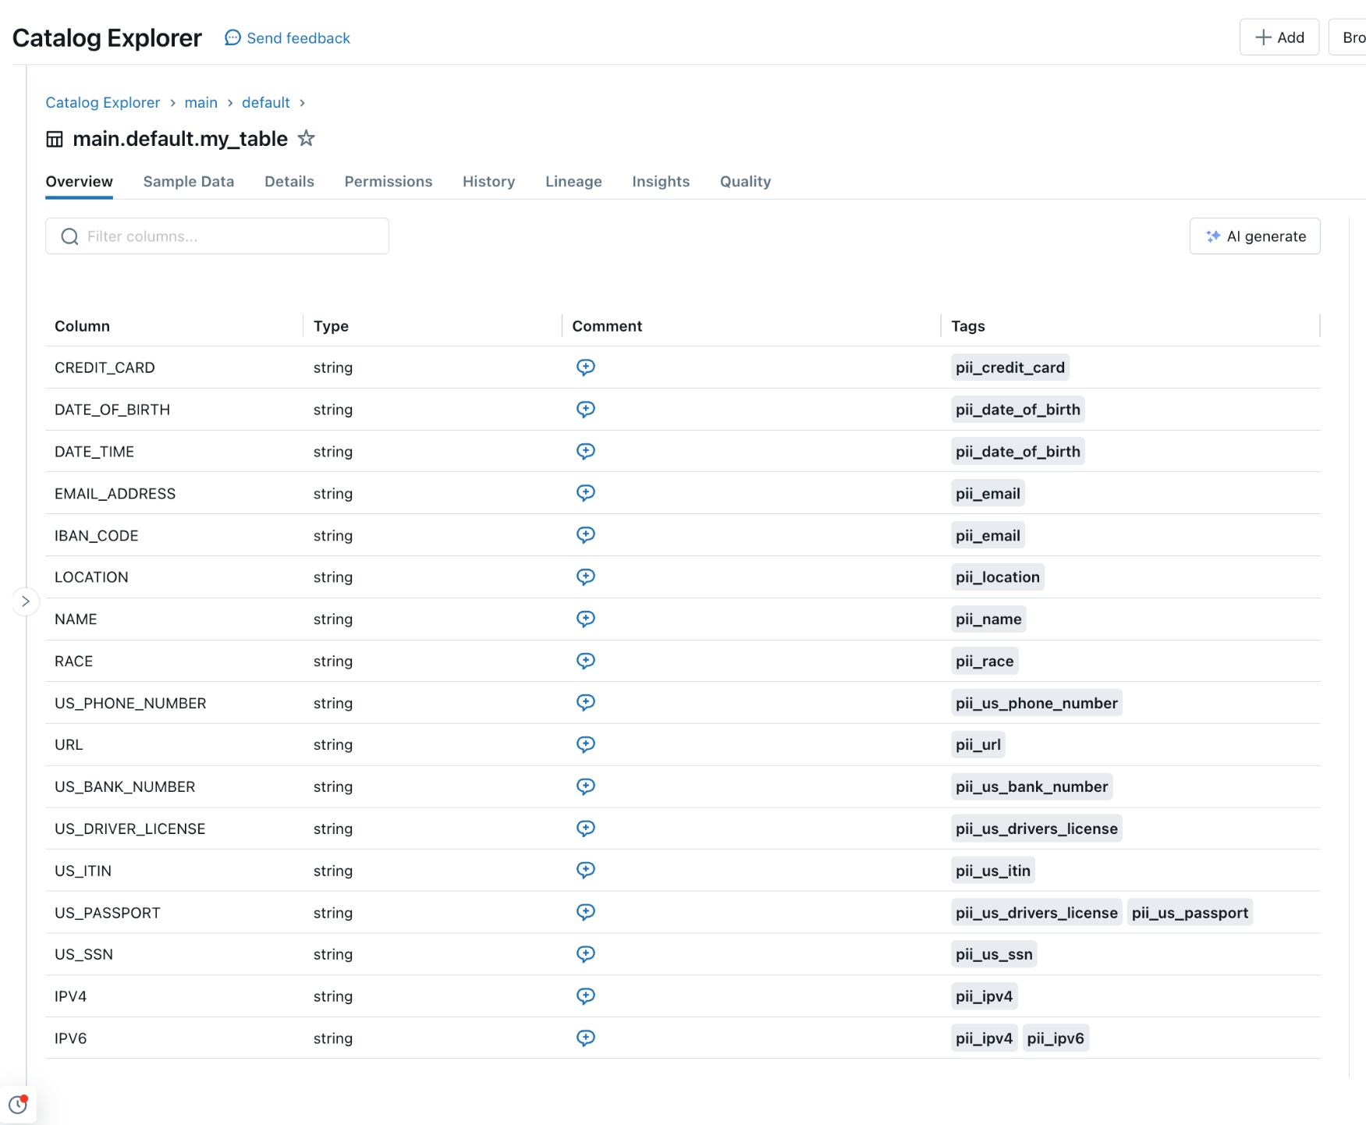
Data Classification
In Private Preview
Automatically scan tables for PII
Built-in classifiers for 16 types of PII
Get alerted when new PII is caught in a column
Support for custom rules and ABAC policies to follow

Slide 24


Get started with Lakehouse Monitoring
Data Classification or Expectations Private Preview:
Lakehouse Monitoring DBdemo:
Sign up form here
Get a product tutorial here

